Slide 1



Trends in self-employment
The rise of self-employment- entrepreneurial or exploitative?
Mixed evidence + feminist critique
Case study
Contesting bogus self-employment research
Case study of foster care ‘workers’

Slide 2
Self-employment 1959-2017 (% jobs)
UK (ONS, 2018)
Notes:
Self-employment in Scotland has grown significantly in recent years, faster than in many other countries.
It has accounted for almost half of overall employment growth over the past decade (45% of growth 2005-16) (slightly lower than the UK).
Self-employment in Scotland, however, accounts for just over 1 in 10 jobs, lower than in many other countries.
Compared to other countries, Scotland has a lower self-employment rate; however, it has one of the highest rates of growth in self-employment.4

Slide 3
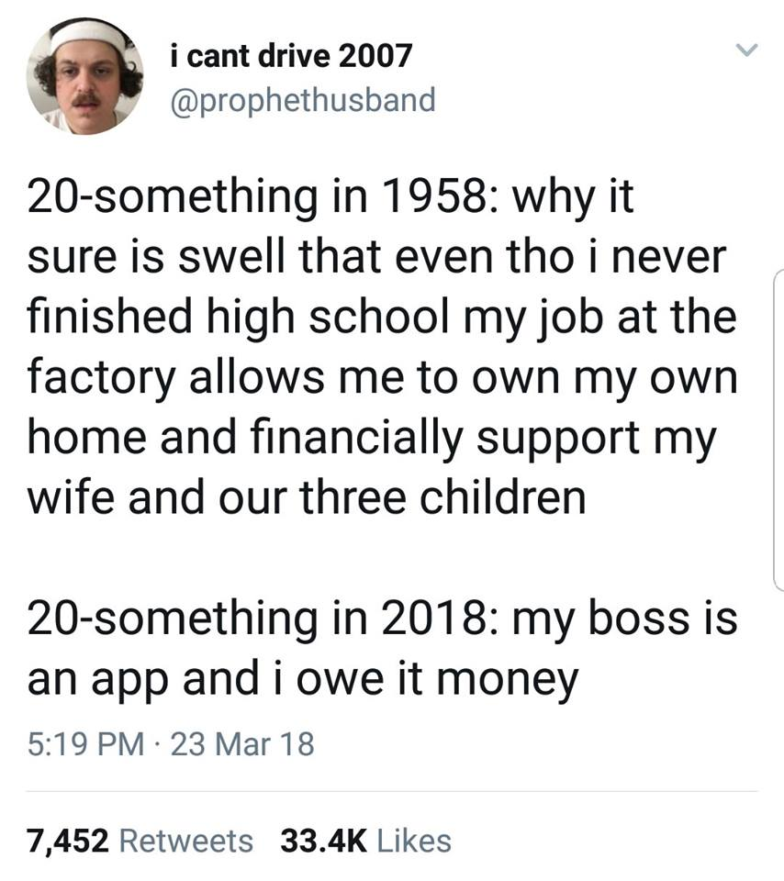

Slide 4
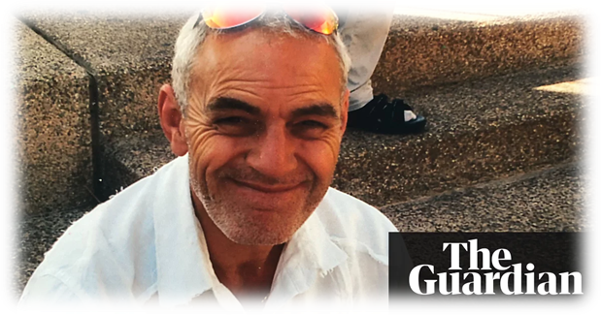
Entrepreneurial or exploitative?
“Self-employment used to be the dream. Now it’s a nightmare” (Fleming, 2016)
Increasing proportion as ‘bogus’?
-Worst of both worlds
Estimates of 10.5% (Citizens Advice, 2015) to 20-30% (Heyes & Hastings, 2017)
Mixed evidence on SE v employee/worker comparisons
Risks of BSE?
Death, (no)taxes and poverty?
Notes:
Controversy- government has been keen to flout the good news story but there are questions over the quality of the that employment- including underemployment and the conditions of work, particularly for those who are deemed to be outside traditional contracts. Especially SE.
Rise of SE
Questions over whether there has been a fundamental shift in the nature of SE
-some evidence to suggest that it has changed from the thing many used to aspire, to something we must accept, begrudginly.
Shouldn’t overstate the doommongering & extensiveness of issue- probably more accurate to say that it is a nightmare for a small but growing proportion of the workforce who are BSE
Don Lane. SE courier for DPD- fines of £150 per missed day. He had collapsed twice while at work, once having fallen into a diabetic coma behind the wheel. Was afraid of pressure from DPD. Had worked for DPD for 19 years.

Slide 5

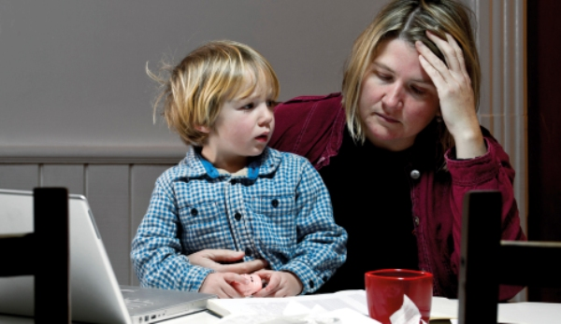
Degradation of SE, following feminisation?
40% of employment growth 2008-16 (BIS, 2016: 3)
Rise in SE with no employees (ONS, 2018)
Increase in those reporting necessity over choice (Resolution Foundation, 2014)
£ Gap with employees is widening (CIPD, 2018)
£240 pw v £400 (modal earnings), falling faster than employee earnings (BIS, 2016)
from male/FT dominated> increasingly female, part-time and lower-earnings (CIPD, 2018, BIS, 2016).
SE a premium for part-time men, but part-time SE women are paid less (ONS, 2018: 26)
Continued segregation- growth of care and cleaning. Gender segregation in gig work (Balaram et al, 2017: 18)
Notes:
Available data from LFS, FRS, census data and targeted surveys e.g. by RSA and CIPD.
In addition to the contemporary twist of the gig economy (CIPD: 2018
We know SE is highly diverse
barristers to baristas
Many value flexibility & relatively satisfied,

Slide 6
SE by industry 1978-2017

Slide 7
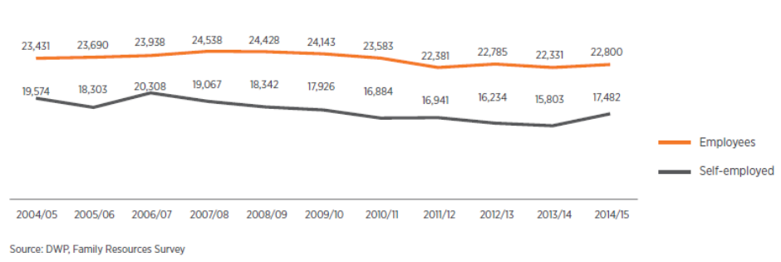
Median real income SE & employees
Notes:
FRS, DWP
CIPD 2018: 12
Earnings-
For the UK as a whole, the median annual gross earnings of self-employed people was £12,200 in 2014/15, considerably lower than that for employees (£20,450), and it is likely that the situation is similar in Scotland18. Research suggests that hourly earnings of almost half of self-employed people are below the level of the National Living Wage19 (which does not cover the self-employed).
At the UK level, median annual earnings (in real terms) from self-employment have declined by 16% since 2007/08, much faster than for employees (-10%)20. The reasons for this are unclear, but it could be due to the growth. (R&S: 9-10)

Slide 8
Self-employment is higher in low-income countries
Notes:
OECD- (self-employed in main job aged 15 and over as % of employment) CIPD 2018: 19
CIPD, 2018: 19
In contrast, the self-employment rate is highest in ‘low income’ countries (IMF definition) and the Middle East and
North Africa (Gindling et al 2016). In 14 ‘high income’ countries (IMF definition, includes the UK), the self-employed faced an average wage penalty
of 24% relative to employees (Gindling et al 2016). The combination of lower income but comparable standards of living seen in the UK is seen in other European countries
(Horemans and Marx 2017).

Slide 9
Work related well-being
Notes:
CIPD 2018: 18- 2015 employee outlook data

Slide 10
Positive feelings about work
Notes:
CIPD 2018: 19
SKIlls and employment surveys 2012

Slide 11
Satisfaction with working conditions across Europe
Notes:
2015
CIPD, 2018: 19

Slide 12
Do we have the full picture?
“There is no obvious problem with self-employment as a labour force choice and little evidence that conditions are getting worse.” BIS (2016:14)
But pockets of ‘problematic precarity’?
e.g. social care (Hayes, 2017, Hayes and Moore, 2016)

Slide 13

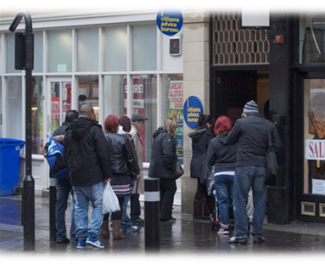



Contesting Bogus Self-employment: an examination of problematic precarity
Where does BSE occur?
What problems arise from it?
Are people contesting it?
Multiple method design
Interviews
Observation & documentary/textual analysis
Notes:
What are the sectors and situations in which BSE is arising? What’s driving it?
To what extent are people challenging it?

Slide 14
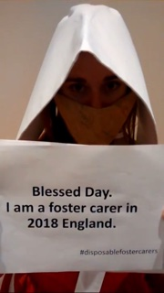
Foster care workers campaign
Often couples, but 85-90% main carers are women
Organising rapidly since 2016
Recognised selves in media reports of BSE
“Do work that is set out for them in a written agreement, and they are highly supervised, yet they have no employment rights. And these rights couldn’t be more needed… [some] foster care workers not being paid enough to cover basic essentials, [others suffer] of unfair “de-registrations.” (Union official, IWGB)
Notes:
https://www.youtube.com/watch?v=liGlE10slOs&feature=share
On demographics
https://dspace.lboro.ac.uk/dspace-jspui/bitstream/2134/11975/3/Foster%20Carer%20Demographics%20report_23_MAY_2012_FINAL.pdf
Highly controlled, partly as response to some abuse scandals but has become v difficult for workers

Slide 15

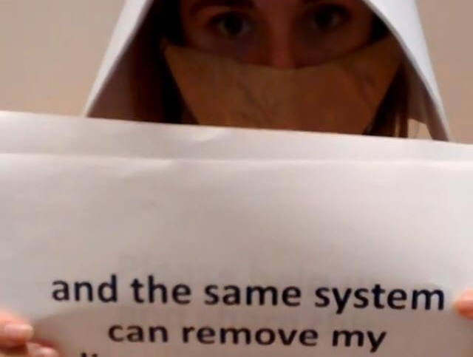
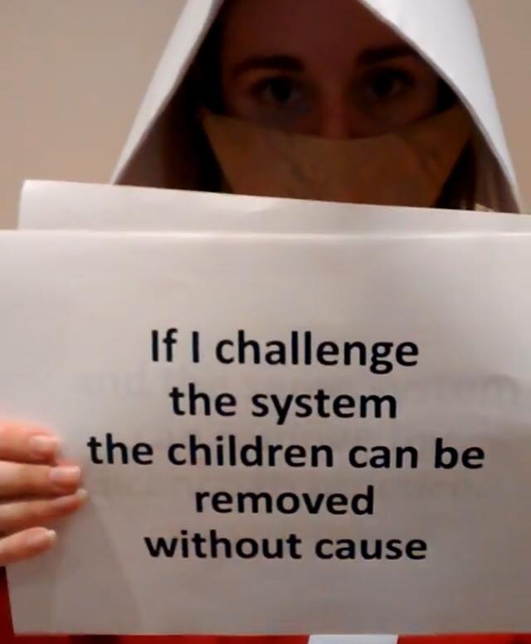
Lack of due process or protection from ‘dismissal’
Notes:
Case in a Glasgow ET was an important call to arms for other foster carers

Slide 16
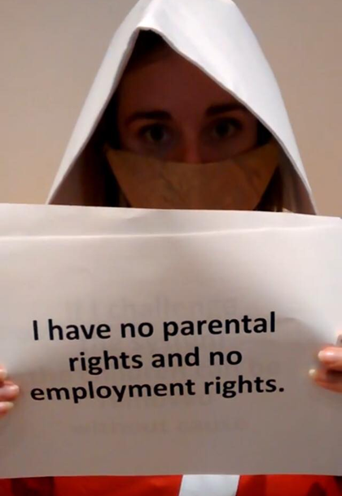
‘Just parents’/unpaid work in the home v ‘workers’
“This question doesn’t get asked of other people who are motivated by doing good but also make a living from their profession, such as doctors or teachers, if people are concerned about the fair use of money in fostering then I would suggest asking questions of those who are actually getting that money, such as local authorities’ directors of children services, some of whom earn more than £130,000 per year, or private fostering agencies who make millions in profits.” (IWGB rep)
“The desire for working rights and decent pay should not be questioned for those who dedicate 24 hours a day, seven days a week, to looking after children and young people in the most vulnerable of situations.” (IWGB rep)
Notes:
FCW campaign in against false dichotomy of love/care vs work.

Slide 17
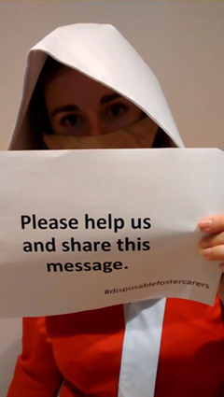
Seeking a foster care workers’ rights bill
Creation of a national, independent, gov-accredited body
Employment status as leverage point
claims for the valuing of their work, and indeed recognition that it is ‘work’
Seeing success in shifting narrative
Leads to wider questioning of political economy of care, the centrality of work, UBI.

